Slide 1


ITC — Information Technology Colleague
رواد مصر الرقمية
GRADUATION
PROJECT
Powerful • Modern • Premium
Testing
QA Engineering
2025 / 2026
DEPI_SWD6

Slide 2
Overview
AGENDA
What we'll cover today
This presentation covers our graduation project from inception to delivery — walking through every stage of our QA testing lifecycle, methodology, and final results.
01 Introduction
02 Problem Statement
330
330
0
4
03 Solution Overview
04 System Design
Test Cases
Passed
Failed
Bugs
05 Demo
06 Conclusion

Slide 3
Project Overview
Team · Tech Stack · Supervisor
The Team
Project Name
Booking.com Testing & Automation Project
Jana Mohamed
Juliana George
J
J
Team Leader
QA Engineer
Tech Stack
Selenium Webdriver , Java , Maven , Postman , Github , Manual Testing
Waad Ahmed
Rewan Ahmed
W
R
QA Engineer
QA Engineer
Supervisor
Basil Khalid
Basmala Mohamed
B
W
Wesal Emad
QA Engineer
QA Engineer

Slide 4
PROBLEM
Problem
01
Efficiency
Statement
Reduced testing effort and improved test coverage.
Booking.com is a widely used platform for hotel and travel reservations, where users need a smooth and reliable experience when searching, logging in, managing their accounts, and completing bookings. However, without proper testing, the system may contain functional defects, usability issues, security problems, or performance failures.
These issues can negatively affect user experience, cause booking failures, lead to user dissatisfaction, and reduce trust in the platform. Therefore, comprehensive testing is required to ensure the application's quality, reliability, and stability across different scenarios and browsers.
Impact:
Users may face difficulties during login or account recovery.
Booking processes may fail or contain errors.
Poor user experience can lead to customer loss.
Undetected bugs may affect system reliability and security.
02
Quality
Improved application reliability and user experience.
03
Time
Reduced testing time and faster bug detection

Slide 5
Proposed Solution
Main Solution
Advantages
Manual & automation testing for Booking website.
API testing for Restful Booker using Postman
Faster test execution with automation.
Clear defect detection and reporting.
Practical experience with real-world tools
Tools & Stack
Expected Outcomes
Selenium / WebDriver
Postman
Excel for test cases
Java (automation scripts)
Reliable test coverage for Booking workflows.
Validated API endpoints with structured cases.
Improved team skills in QA and automation

Slide 6
System
1. Test Design
2. Test Implementation
Design
3. Test Report
Test Planning
Test Execution
Defect Management
User Stories
Test Scenarios
Test Cases
Test Data
Manual Testing
Automation Testing (Selenium)
Cross Browser Testing
API Testing (Postman)
Bug Reports
Bug Tracking
Test Execution Reports
Test Results Analysis

Slide 7
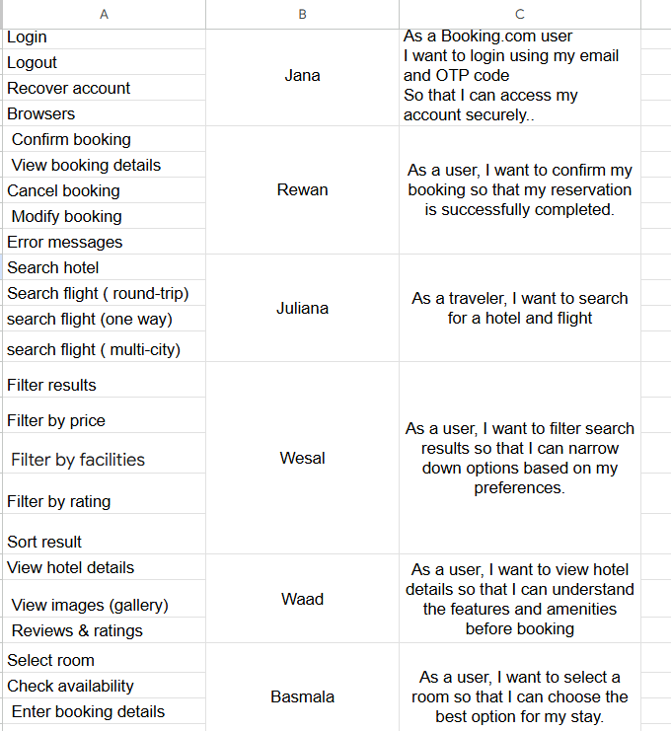
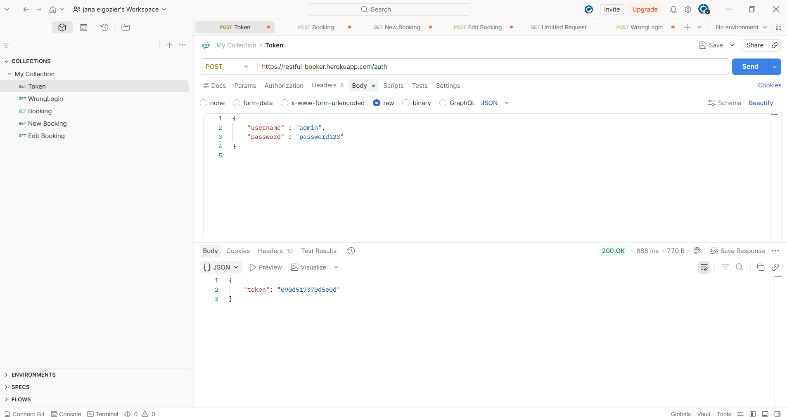
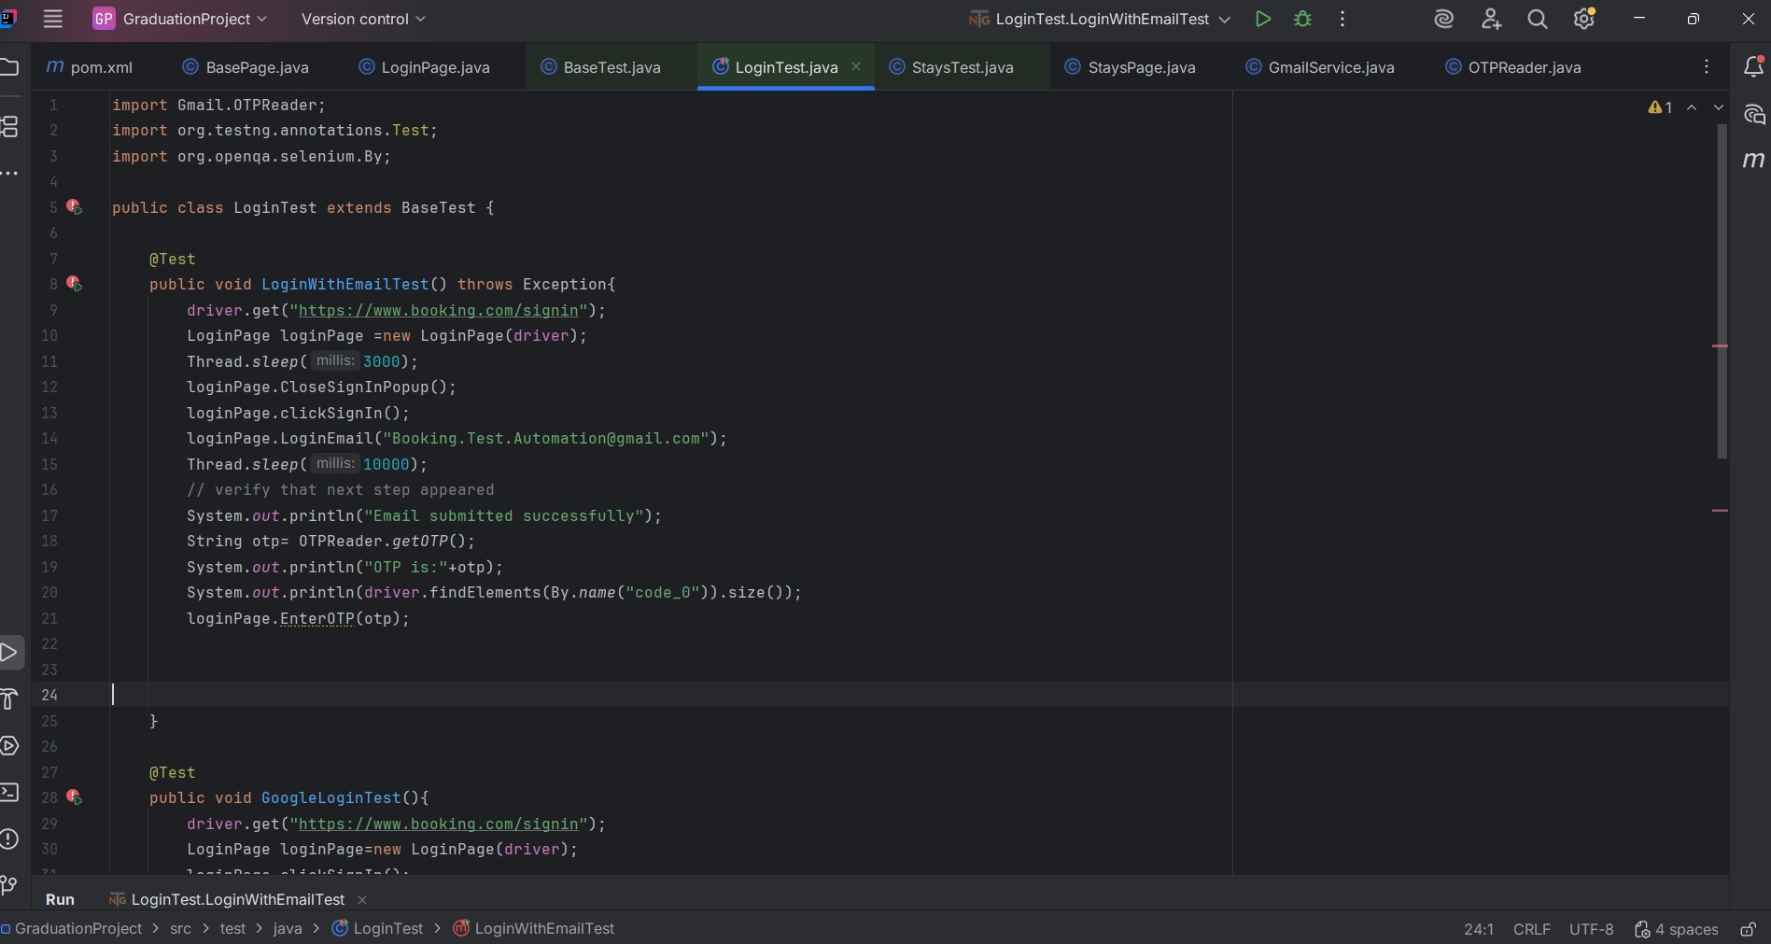
Demo &
Screenshots
Screenshot 1
Screenshot 2
Screenshot 3

Slide 8
QA Results Dashboard
Testing Team — Final Metrics
330
330
0
4
Total Test Cases
Passed
Failed
Bugs Found

Slide 9
Conclusion
Summary
Thank
Manual testing for Booking website.
Automation scripts with Selenium/WebDriver.
API testing for Restful Booker using Postman.
You!
Learnings
Difference between manual and automation testing.
Writing clear and structured test cases.
Handling API issues (auth, errors)
Jana Mohamed— Team Leader
ITC Graduation Project
Future Work
Add performance testing.
Expand automation coverage.
Integrate testing with CI/CD pipeline

